Slide 1
Employee Data Analysis using Excel
STUDENT NAME:K.MOHAMMED ILIYAS
REGISTER NO: 312214526/DAE8B70C17ACCCBA132494A8F8202623
DEPARTMENT: DEPARTMENT OF COMMERCE
COLLEGE: ST THOMAS COLLEGE OF ARTS AND SCIENCE

Slide 2
PROJECT TITLE
VISUALISING EMPLOYEE ATTENDANCE TRENDE WITH EXCEL CHARTS

Slide 3


AGENDA
Problem Statement
Project Overview
End Users
Our Solution and Proposition
Dataset Description
Modelling Approach
Results and Discussion
Conclusion
3/21/2024 Annual Review

Slide 4

PROBLEM STATEMENT
[
[
To effectively visualize and analyze employee attendance data over time using Excel charts. The goal is to identify patterns, trends, and anomalies in attendance, which can aid in decision-making regarding workforce management and policy adjustments.

Slide 5

PROJECT OVERVIEW
.
To analyze and visualize employee attendance data using Excel charts to identify trends, patterns, and areas for improvement.

Slide 6

WHO ARE THE END USERS?
Gather employee attendance data, including dates, employee names, and attendance status (e.g., present, absent, late).

Slide 7
OUR SOLUTION AND ITS VALUE PROPOSITION
Our solution offers a comprehensive approach to visualizing employee attendance trends using Excel charts. By integrating data analysis with clear graphical representations, we make it easier for organizations to monitor attendance patterns and identify trends over time.

Slide 8
Dataset Description
Employee- KAGGLE
26-Features
9-Features
Emp Id- Number
Name Text
Emp-Type
Current Employee Rating- Number
Gender- Male Female
Employee Rating-Number

Slide 9

THE "WOW" IN OUR SOLUTION
*=IFS(28>=5,"VERY HIGH",28>=4,"HIGH" 28>=3,"MED", TRUE, "LOW")
3/21/2024 Annual Review
9

Slide 10
MODELLING
Prepare Your Data:Data Collection: Ensure you have data on employee attendance, including dates, employee IDs/names, and attendance status (e.g., present, absent, late).Data Organization: Structure your data in a table format with columns for Date, Employee ID/Name, and Attendance Status. Include additional columns if needed (e.g., Department).
10

Slide 11
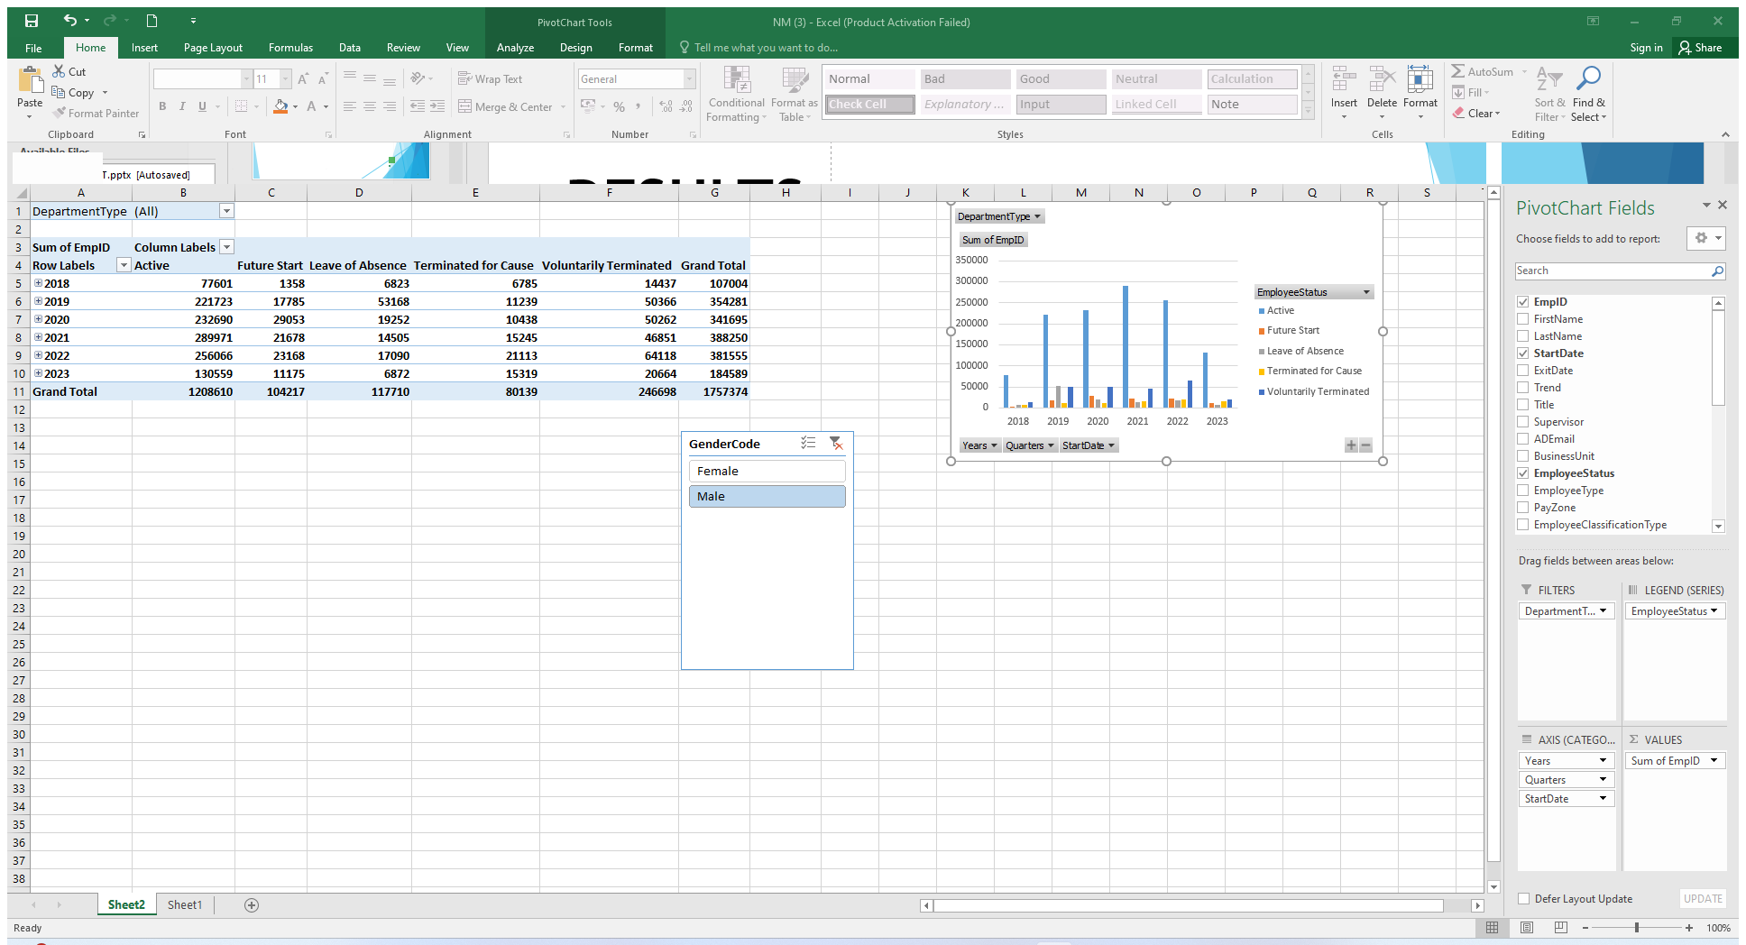
RESULTS
11

Slide 12
conclusion
In conclusion, effectively visualizing employee attendance trends in Excel involves a strategic approach to data organization and presentation. By using pivot tables and dynamic charts such as line, column, and stacked column charts, you can clearly illustrate attendance patterns, compare different data points, and highlight trends over time. Enhancing these visualizations with trendlines, conditional formatting, and interactive dashboards further improves clarity and usability, enabling stakeholders to make informed decisions and identify areas needing attention. This approach not only simplifies complex data but also provides actionable insights into attendance management.

